Slide 1
TO PRACTICE NON-VIOLENCE

Slide 2
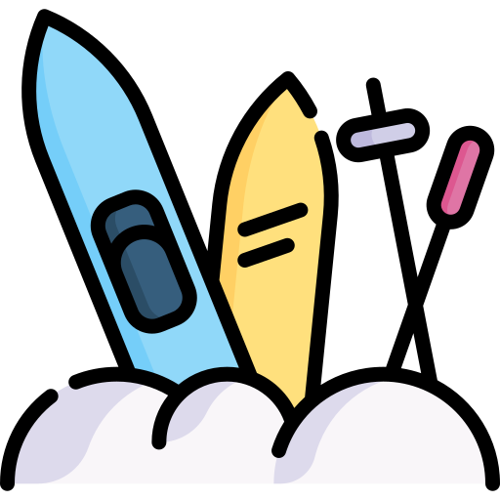
WOULD YOU RATHER
Go to the beach
Go to the snow

Slide 3
OBJECTIVES
Discuss what it means to practice non-violence
Learn about the different ways to solve conflict using non-violence
Reflect on making the choice to solve conflicts in healthy ways

Slide 4
PRACTICING NON-VIOLENCE
Relationships can sometimes be hard, especially when there is conflict.
Making the choice to practice non-violence can help you deal with conflict in a healthy way.
There are a few steps you can follow to solve conflict using non-violence

Slide 5
WHAT DOES IT MEAN TO CHOOSE
NON-VIOLENCE WHEN FACING CONFLICT?
Non-violence is the personal choice to not cause harm when facing conflict.
Conflict is a normal part of all relationships. You can choose to solve conflict without hurting the other person.

Slide 6
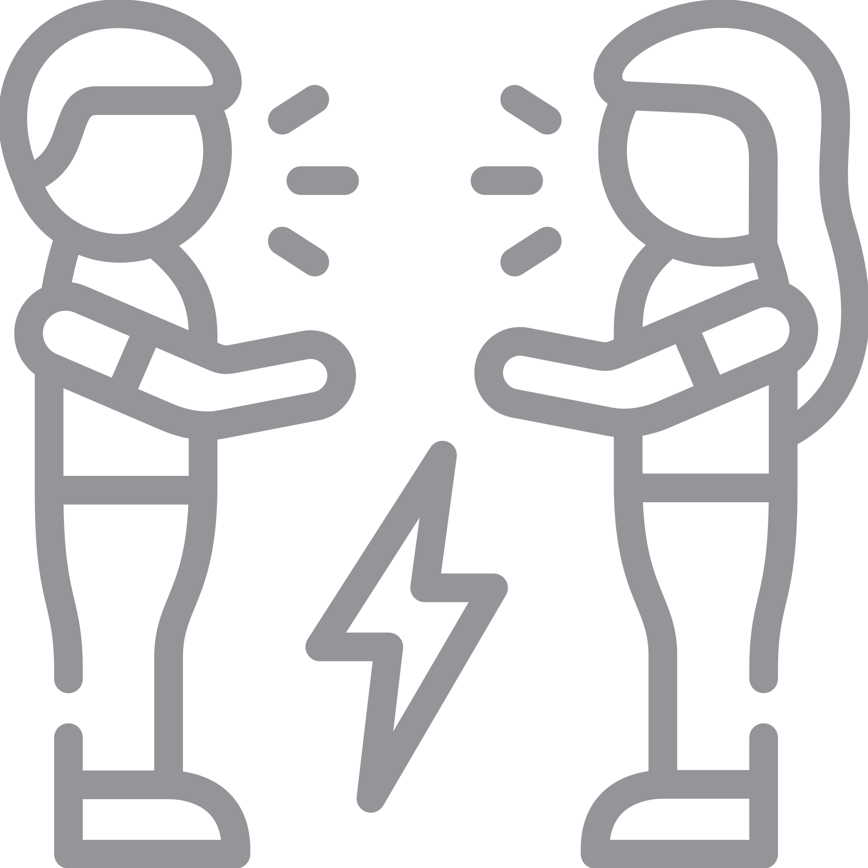
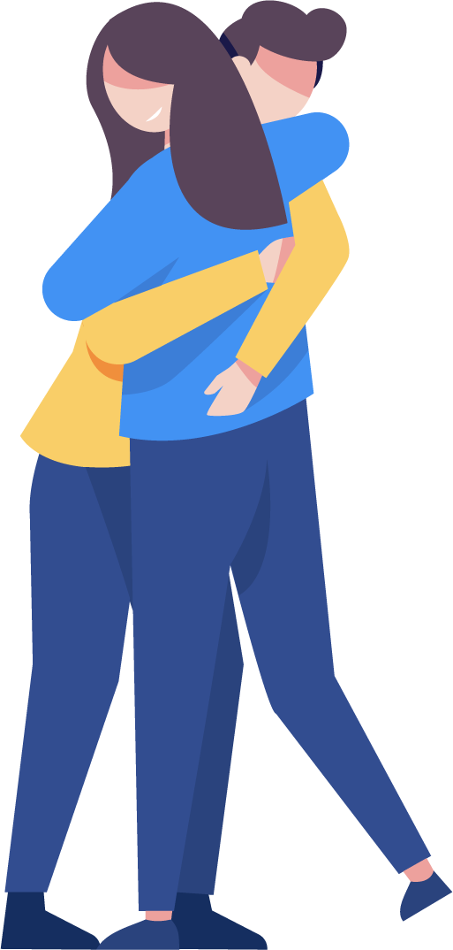
CONFLICT IN RELATIONSHIPS CAN LOOK LIKE:
Being afraid of having honest communication
Having a disagreement
Being upset about something you don’t feel comfortable with
Feeling scared to express your point of view without being judged

Slide 7
RESOLVING CONFLICT
Notes:
https://youtu.be/QyXFirOUeUk

Slide 8
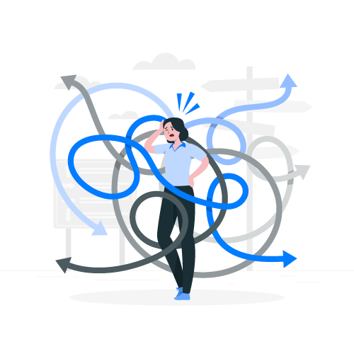
DISCUSSION
What kind of choices do you make when trying to solve conflicts?

Slide 9
SIX STEPS TO SOLVE CONFLICT USING NON-VIOLENCE
Discuss and identify the problem
Brainstorm possible solutions
Evaluate a solution
Choose a solution
Apply the solution
Re-evaluate the solution later

Slide 10
NON-VIOLENT CONFLICT RESOLUTION
Discuss and Name the Problem
Brainstorm Possible Solutions
Look at each other's point of view
Use active listening
Focus on the problem, not the person
Use open and honest communication
Focus on solutions, not blame
Allow everyone to express their wants and needs
Validate everyone's opinions
Look for solutions that work for all parties

Slide 11
NON-VIOLENT CONFLICT RESOLUTION
Evaluate and Select the Solution
Choose a Solution
After identifying possible solutions, work together to select one to try
Practice mutual understanding
Negotiate a solution that fits everyone well
Take accountability
Set responsibilities and actions that everyone is going to take for the solution to work long term
Select the solution together

Slide 12
NON-VIOLENT CONFLICT RESOLUTION
Try the Solution
Re-Evaluate the Solution As Needed
Check in with each other to make sure everyone is feeling okay
Give each other time and space as needed
Continue to check in with everyone to ensure the agreed upon solution continues to work for all
Remember that change is normal
Re-evaluate the solution as needed

Slide 13
Do you think using these 6 steps can help you choose non-violence?
DISCUSSION

Slide 14
HOW DO YOU DEAL WITH CONFLICT?
Notes:
https://youtu.be/pUI9-MwCmGM

Slide 15
DISCUSSION
Why is it important to choose non-violence when facing conflict?
What are other ways you can practice non-violence?
How have you practiced non-violence?

Slide 16
Make a Choice!
Understanding how you deal with conflict can help you to make more productive choices.
Try to make the following choices when trying to solve conflict:
Talk directly about the problem
Refrain from pretending that there is nothing going on
Confront the problem, not the person
Find a way to compromise to preserve the relationship (when possible)

Slide 17
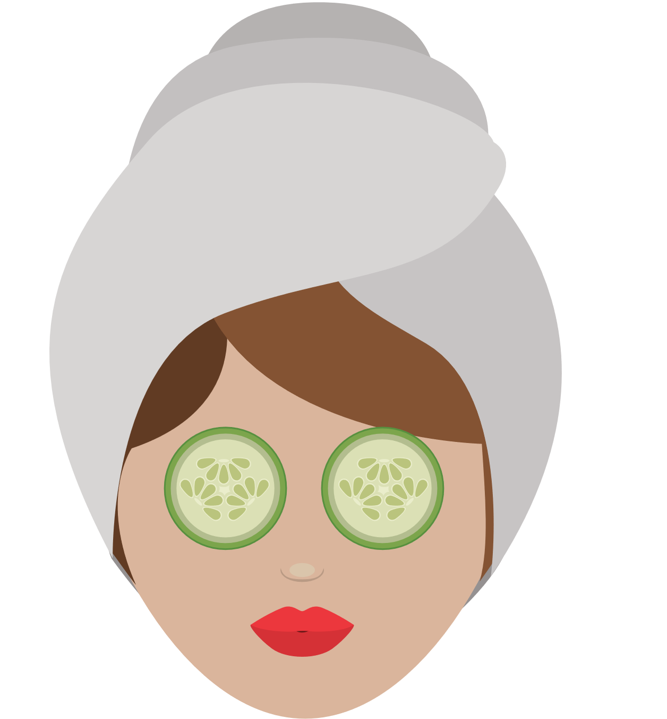
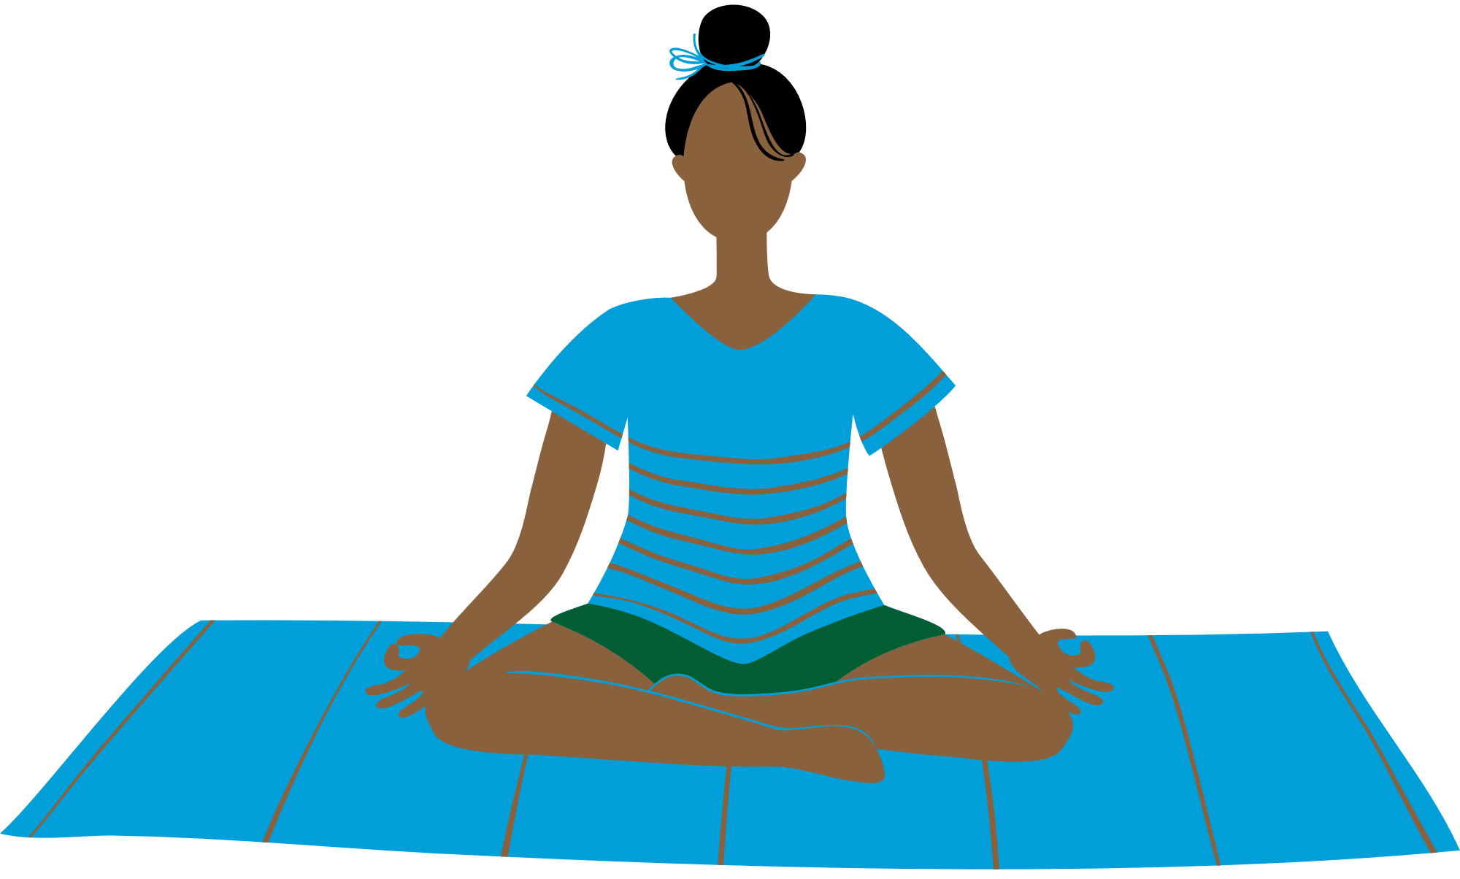
CHECK OUT
What will you do for yourself today?
Self Pampering
Workout
Read a Book
Meditate
Listen to Music

Slide 18
Committed to fostering a safe and respectful District, school and community culture where the seeds of peace and justice are sown so that all students and staff can lead safe, purposeful and academically fruitful lives.
Connect with us at bit.ly/LAUSD-HRDE

